Slide 1
Statistical Language Models
Hongning Wang
CS@UVa

Slide 2
Today’s lecture
How to represent a document?
Make it computable
How to infer the relationship among documents or identify the structure within a document?
Knowledge discovery

Slide 3
What is a statistical LM?
A model specifying probability distribution over word sequences
p(“Today is Wednesday”) ≈ 0.001
p(“Today Wednesday is”) ≈ 0.0000000000001
p(“The eigenvalue is positive”) ≈ 0.00001
It can be regarded as a probabilistic mechanism for “generating” text, thus also called a “generative” model

Slide 4
Why is a LM useful?
Provide a principled way to quantify the uncertainties associated with natural language
Allow us to answer questions like:
Given that we see “John” and “feels”, how likely will we see “happy” as opposed to “habit” as the next word?
(speech recognition)
Given that we observe “baseball” three times and “game” once in a news article, how likely is it about “sports” v.s. “politics”?
(text categorization)
Given that a user is interested in sports news, how likely would the user use “baseball” in a query?
(information retrieval)

Slide 5
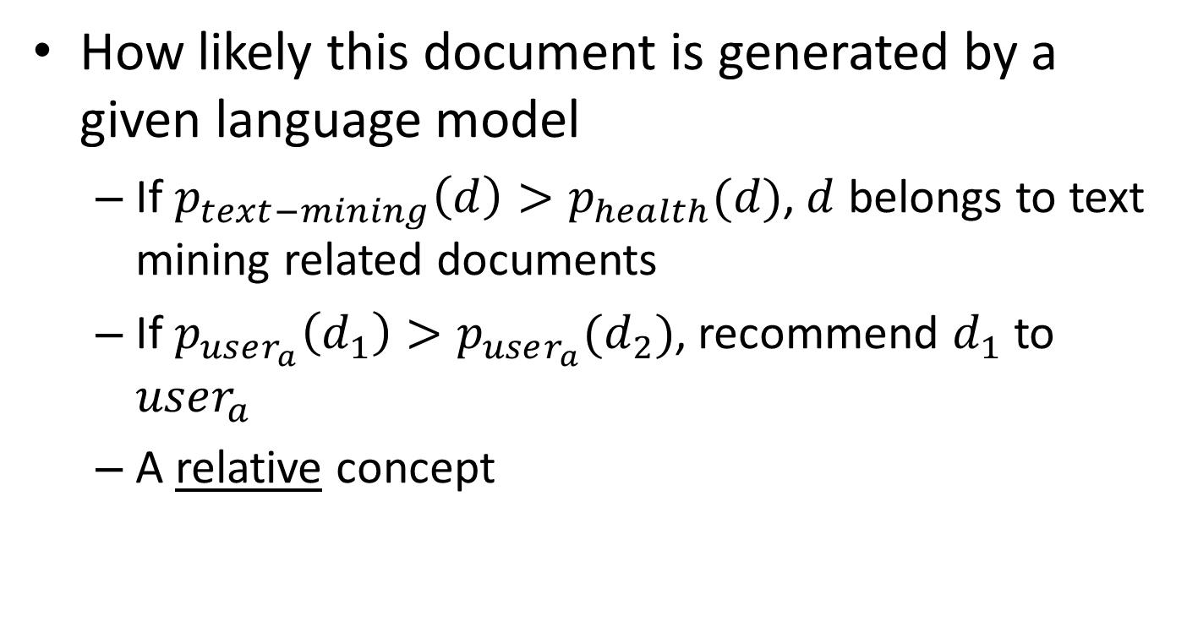
Measure the fluency of documents
How likely this document is generated by a given language model
If $p_{text−mining}\left(d\right)>p_{health}(d)$, $d$ belongs to text mining related documents
If $p_{user_{a}}\left(d_{1}\right)>p_{user_{a}}(d_{2})$, recommend $d_{1}$ to $user_{a}$
A relative concept

Slide 6
Source-Channel framework ^{[Shannon 48]}
Source
Transmitter
(encoder)
Noisy
Channel
Receiver
(decoder)
Destination
X
Y
X’
P(X)
P(X|Y)=?
P(Y|X)
(Bayes Rule)
When X is text, p(X) is a language model
Many Examples:
Speech recognition: X=Word sequence Y=Speech signal
Machine translation: X=English sentence Y=Chinese sentence
OCR Error Correction: X=Correct word Y= Erroneous word
Information Retrieval: X=Document Y=Query
Summarization: X=Summary Y=Document

Slide 7
Basic concepts of probability
Random experiment
An experiment with uncertain outcome (e.g., tossing a coin, picking a word from text)
Sample space (S)
All possible outcomes of an experiment, e.g., tossing 2 fair coins, S={HH, HT, TH, TT}
Event (E)
E⊆S, E happens iff outcome is in S, e.g., E={HH} (all heads), E={HH,TT} (same face)
Impossible event ({}), certain event (S)
Probability of event
0 ≤ P(E) ≤ 1

Slide 8
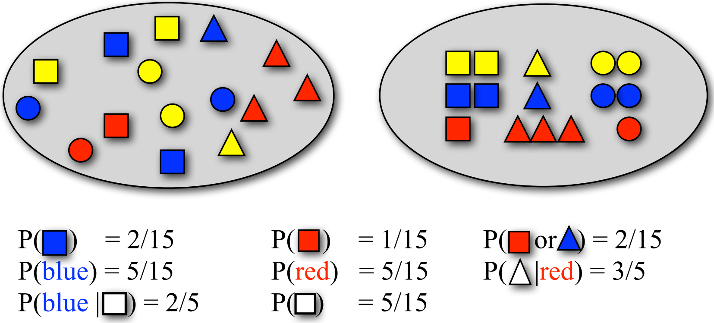
Sampling with replacement
Pick a random shape, then put it back in the bag

Slide 9
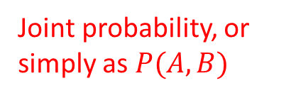
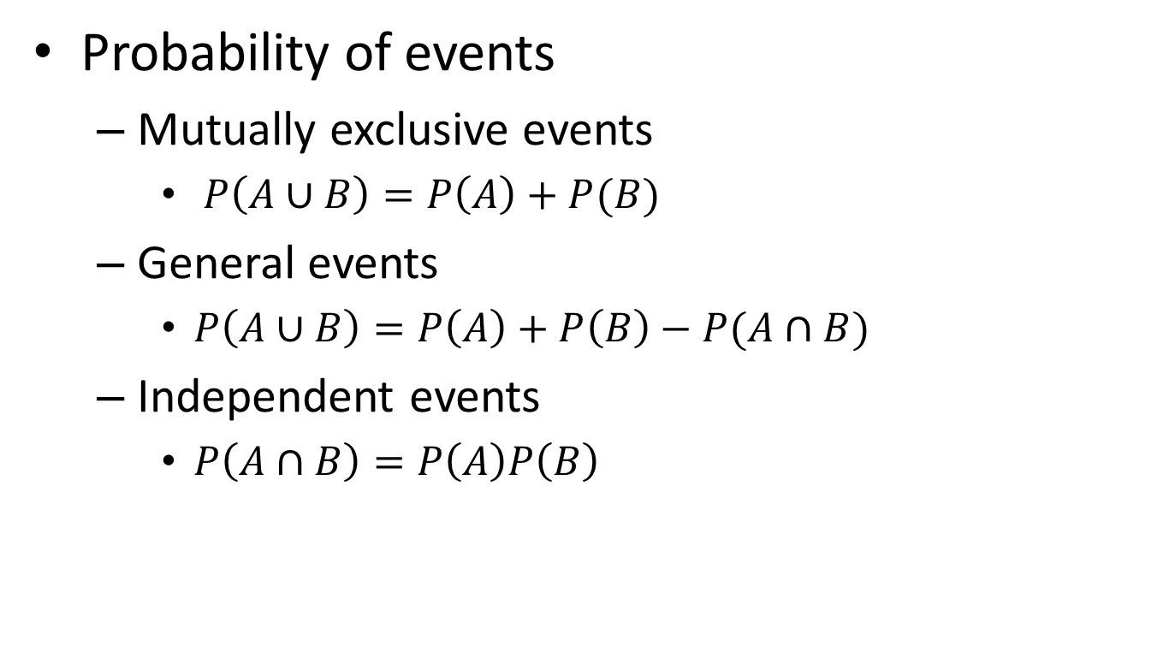
Essential probability concepts
Probability of events
Mutually exclusive events
$P\left(A∪B\right)=P\left(A\right)+P(B)$
General events
$P\left(A∪B\right)=P\left(A\right)+P\left(B\right)−P(A∩B)$
Independent events
$P\left(A∩B\right)=P\left(A\right)P\left(B\right)$
Joint probability, or simply as $P(A,B)$

Slide 10
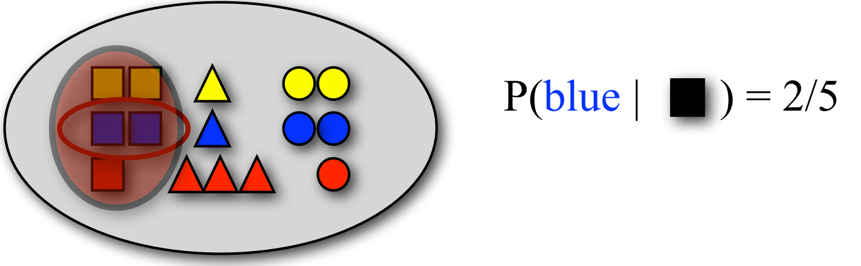

Essential probability concepts
Conditional probability
$P\left(B | A\right)=P(A,B)/P\left(A\right)$
Bayes’ Rule: $P\left(B | A\right)=P\left(A | B\right)P(B)/P\left(A\right)$
For independent events, $P\left(B | A\right)=P(B)$

Slide 11

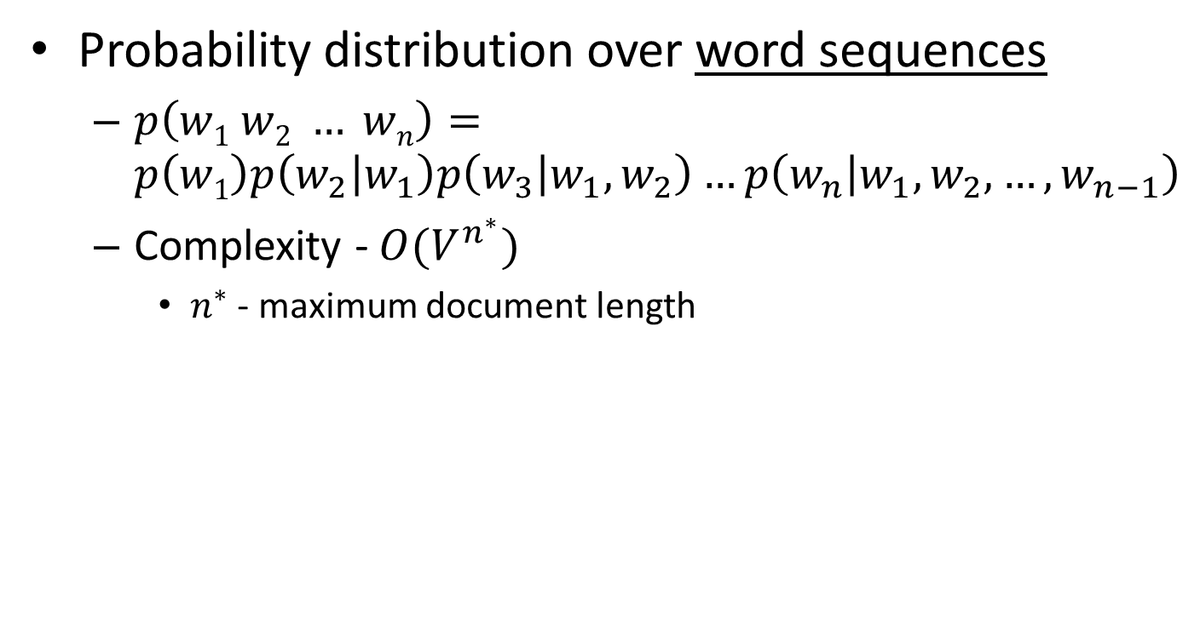

Language model for text
We need independence assumptions!
Probability distribution over word sequences
$p\left(w1 w2 … wn\right)=p\left(w1\right)p\left(w_{2} | w_{1}\right)p\left(w_{3} | w_{1},w_{2}\right)…p\left(w_{n} | w_{1},w_{2},…,w_{n−1}\right)$
Complexity - $O(V^{n^{∗}})$
$n^{∗}$ - maximum document length
sentence
Chain rule: from conditional probability to joint probability
475,000 main headwords in Webster's Third New International Dictionary
Average English sentence length is 14.3 words
A rough estimate: $O({475000}^{14})$
$$\frac{{475000}^{14}}{8bytes×{\left(1024\right)}^{4}}≈3.38e^{66}TB$$
How large is this?

Slide 12
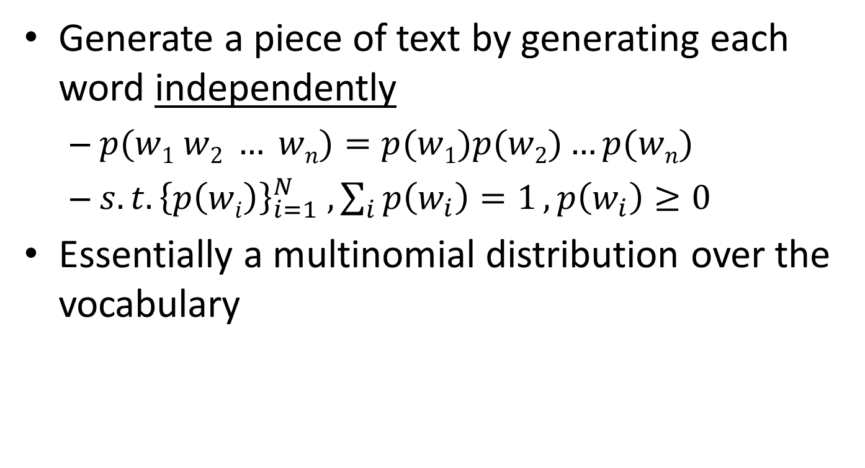
Unigram language model
Generate a piece of text by generating each word independently
$p(w1 w2 … wn)=p(w1)p(w2)…p(wn)$
${s.t. \left\{p\left(wi\right)\right\}}_{i=1}^{N} , \sum_{i}{p\left(w_{i}\right)=1}, p\left(w_{i}\right)≥0$
Essentially a multinomial distribution over the vocabulary
The simplest and most popular choice!

Slide 13
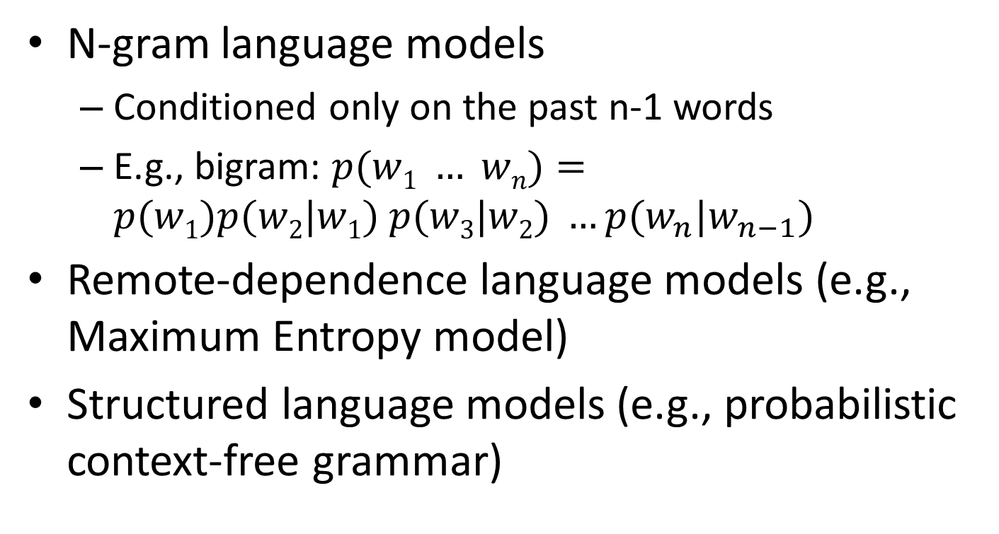
More sophisticated LMs
N-gram language models
Conditioned only on the past n-1 words
E.g., bigram: $p(w1 … wn)=p(w1)p(w2|w1) p(w3|w2) …p(w_{n}|w_{n−1})$
Remote-dependence language models (e.g., Maximum Entropy model)
Structured language models (e.g., probabilistic context-free grammar)

Slide 14
Why just unigram models?
Difficulty in moving toward more complex models
They involve more parameters, so need more data to estimate
They increase the computational complexity significantly, both in time and space
Capturing word order or structure may not add so much value for “topical inference”
But, using more sophisticated models can still be expected to improve performance ...

Slide 15
Recap: what is a statistical LM?
A model specifying probability distribution over word sequences
p(“Today is Wednesday”) ≈ 0.001
p(“Today Wednesday is”) ≈ 0.0000000000001
p(“The eigenvalue is positive”) ≈ 0.00001
It can be regarded as a probabilistic mechanism for “generating” text, thus also called a “generative” model

Slide 16
Recap: Source-Channel framework ^{[Shannon 48]}
Source
Transmitter
(encoder)
Noisy
Channel
Receiver
(decoder)
Destination
X
Y
X’
P(X)
P(X|Y)=?
P(Y|X)
(Bayes Rule)
When X is text, p(X) is a language model
Many Examples:
Speech recognition: X=Word sequence Y=Speech signal
Machine translation: X=English sentence Y=Chinese sentence
OCR Error Correction: X=Correct word Y= Erroneous word
Information Retrieval: X=Document Y=Query
Summarization: X=Summary Y=Document

Slide 17
Generative view of text documents
(Unigram) Language Model θ
p(w| θ)
Sampling
Document
…
text 0.2
mining 0.1
assocation 0.01
clustering 0.02
…
food 0.00001
…
Topic 1:
Text mining
Text mining
document
…
text 0.01
food 0.25
nutrition 0.1
healthy 0.05
diet 0.02
…
Food nutrition
document
Topic 2:
Health

Slide 18
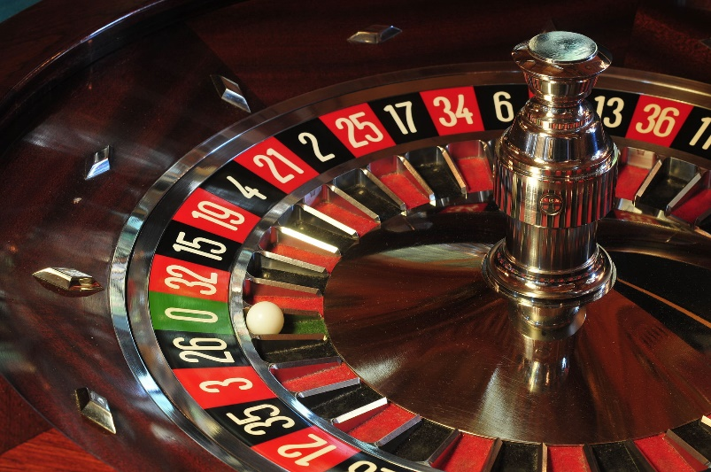
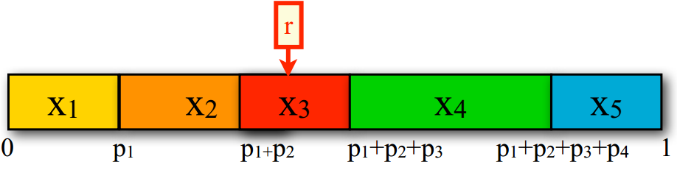

How to generate text from an N-gram language model?
Sample from a discrete distribution $p(X)$
Assume $n$ outcomes in the event space $X$
Divide the interval [0,1] into $n$ intervals according to the probabilities of the outcomes
Generate a random number $r$ between 0 and 1
Return $x_{i}$ where $r$ falls into

Slide 19
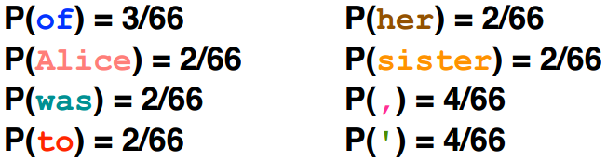
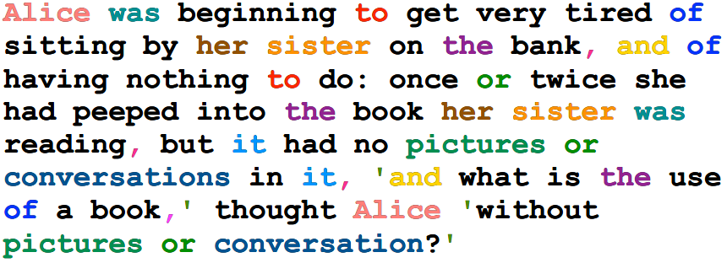
Generating text from language models
Under a unigram language model:

Slide 20
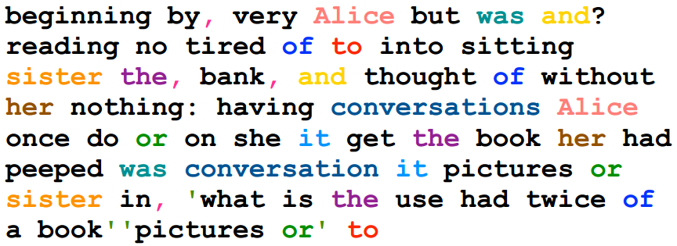
Generating text from language models
Under a unigram language model:
The same likelihood!

Slide 21
N-gram language models will help
Generated from language models of New York Times
Unigram
Months the my and issue of year foreign new exchange’s september were recession exchange new endorsed a q acquire to six executives.
Bigram
Last December through the way to preserve the Hudson corporation N.B.E.C. Taylor would seem to complete the major central planners one point five percent of U.S.E. has already told M.X. corporation of living on information such as more frequently fishing to keep her.
Trigram
They also point to ninety nine point six billon dollars from two hundred four oh six three percent of the rates of interest stores as Mexico and Brazil on market conditions.

Slide 22
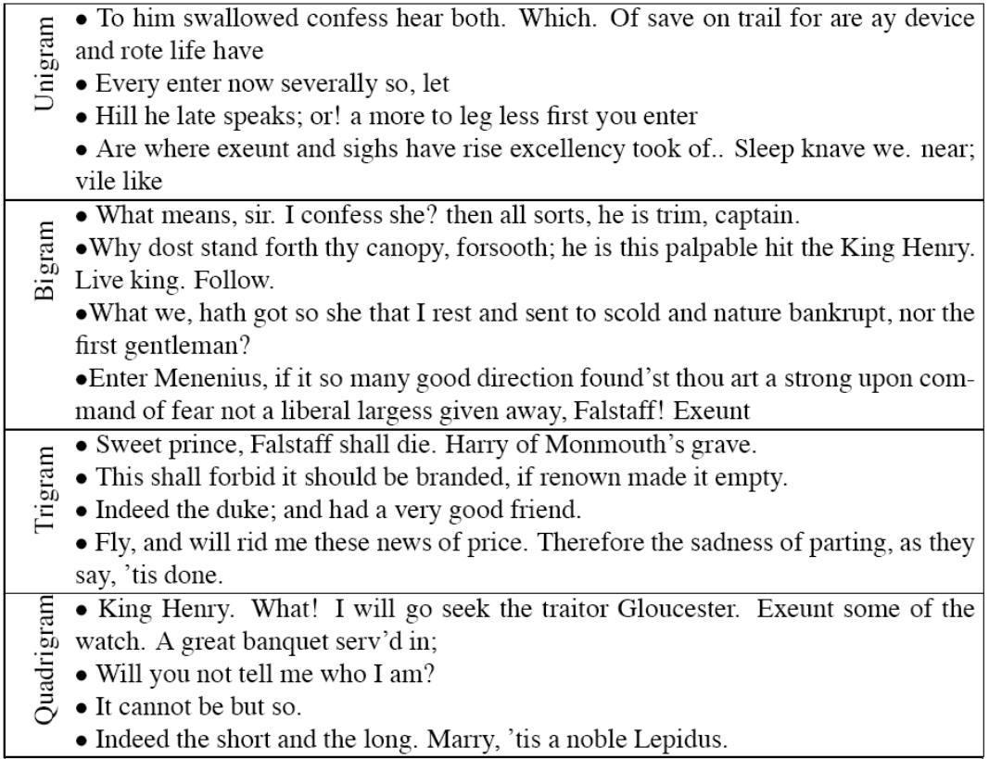

Turing test: generating Shakespeare
A
B
SCIgen - An Automatic CS Paper Generator
C
D

Slide 23
Estimation of language models
Unigram Language Model θ
p(w| θ)=?
Estimation
Document
…
text ?
mining ?
assocation ?
database ?
…
query ?
…
text 10
mining 5
association 3
database 3
algorithm 2
…
query 1
efficient 1
A “text mining” paper
(total #words=100)

Slide 24
Sampling with replacement
Pick a random shape, then put it back in the bag

Slide 25
Estimation of language models
Maximum likelihood estimation
Unigram Language Model θ
p(w| θ)=?
Estimation
Document
…
text ?
mining ?
assocation ?
database ?
…
query ?
…
text 10
mining 5
association 3
database 3
algorithm 2
…
query 1
efficient 1
10/100
5/100
3/100
3/100
1/100
A “text mining” paper
(total #words=100)

Slide 26
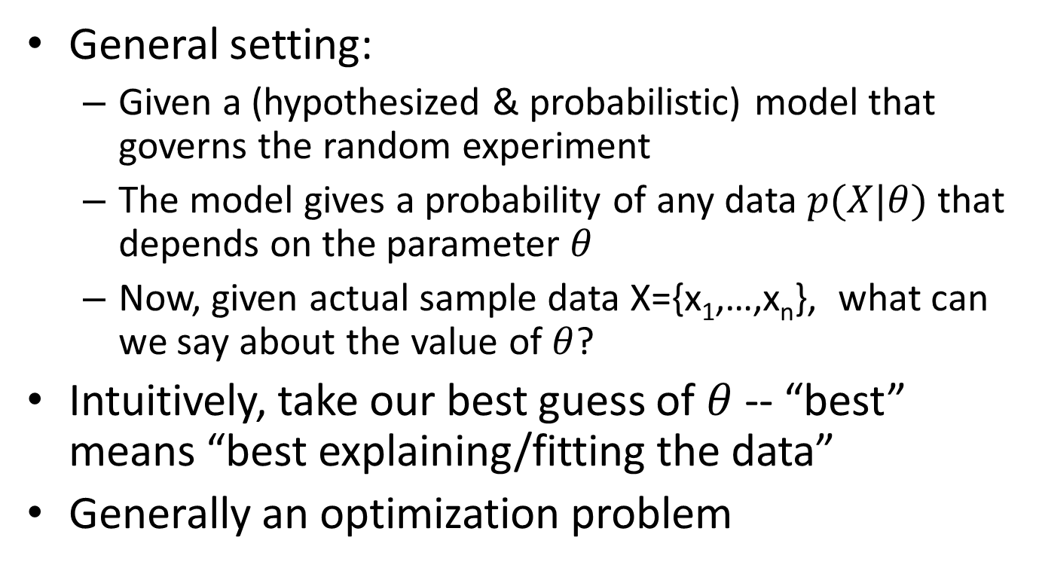
Parameter estimation
General setting:
Given a (hypothesized & probabilistic) model that governs the random experiment
The model gives a probability of any data $p(X|θ)$ that depends on the parameter $θ$
Now, given actual sample data X={x₁,…,x_{n}}, what can we say about the value of $θ$?
Intuitively, take our best guess of $θ$ -- “best” means “best explaining/fitting the data”
Generally an optimization problem

Slide 27

Maximum likelihood vs. Bayesian
Maximum likelihood estimation
“Best” means “data likelihood reaches maximum”
Issue: small sample size
Bayesian estimation
“Best” means being consistent with our “prior” knowledge and explaining data well
A.k.a, Maximum a Posterior estimation
Issue: how to define prior?
$$\hat{θ}={argmax}_{θ}P(X|θ)$$
ML: Frequentist’s point of view
$$\hat{θ}={argmax_{θ}P\left(θ | X\right)=argmax}_{θ}P\left(X | θ\right)P(θ)$$
MAP: Bayesian’s point of view

Slide 28
Illustration of Bayesian estimation
Posterior:
p(θ|X)∝ p(X|θ)p(θ)
Likelihood:
p(X|θ) X=(x₁,…,x_{N})
Prior: p(θ)
θ
θ_{α}: prior mode
θ: posterior mode
θ_{ml}: ML estimate

Slide 29
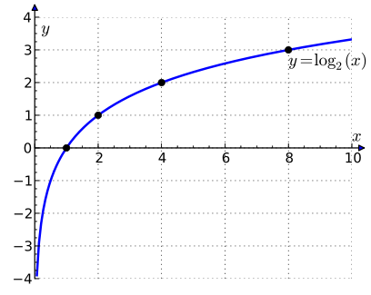
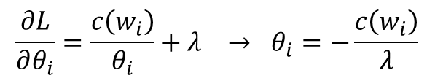

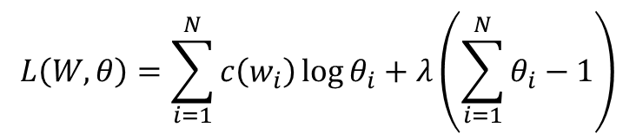
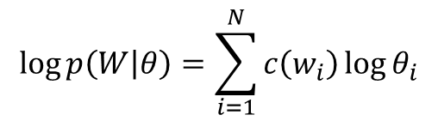

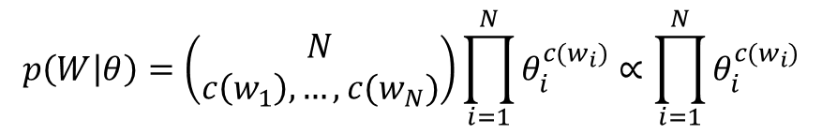

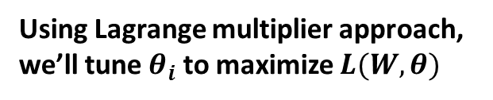
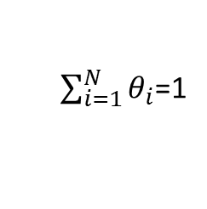
Maximum likelihood estimation
Data: a collection of words, $w_{1},w_{2},…,w_{n}$
Model: multinomial distribution $p(W)$ with parameters $θ_{i}=p(w_{i})$
Maximum likelihood estimator: $\hat{θ}=argmax_{θ}p(W|θ)$
$$p\left(W | θ\right)=\left(\begin{matrix}N \\ c\left(w_{1}\right),…,c(w_{N})\end{matrix}\right)\prod_{i=1}^{N}{θ_{i}^{c(w_{i})}}∝\prod_{i=1}^{N}{θ_{i}^{c(w_{i})}}$$
$$\log{p\left(W | θ\right)}=\sum_{i=1}^{N}{c\left(w_{i}\right)\log{θ_{i}}}$$
$$L\left(W,θ\right)=\sum_{i=1}^{N}{c\left(w_{i}\right)\log{θ_{i}}}+λ\left(\sum_{i=1}^{N}{θ_{i}}−1\right)$$
Using Lagrange multiplier approach, we’ll tune $θ_{i}$ to maximize $L(W,θ)$
$$\frac{∂L}{∂θ_{i}}=\frac{c\left(w_{i}\right)}{θ_{i}}+λ → θ_{i}=−\frac{c\left(w_{i}\right)}{λ}$$
Set partial derivatives to zero
$$λ=−\sum_{i=1}^{N}{c\left(w_{i}\right)}$$
Since
$\sum_{i=1}^{N}{θ_{i}}$=1
we have
Requirement from probability
$$θ_{i}=\frac{c\left(w_{i}\right)}{\sum_{i=1}^{N}{c\left(w_{i}\right)}}$$
ML estimate

Slide 30

Maximum likelihood estimation
For N-gram language models
$p\left(w_{i} | w_{i−1},…,w_{i−n+1}\right)=\frac{c(w_{i},w_{i−1},…,w_{i−n+1})}{c(w_{i−1},…,w_{i−n+1})}$
$c\left(∅\right)=N$
Length of document or total number of words in a corpus

Slide 31
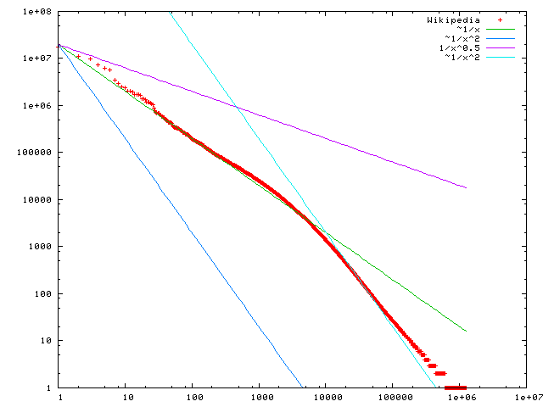

Problem with MLE
Unseen events
We estimated a model on 440K word tokens, but:
Only 30,000 unique words occurred
Only 0.04% of all possible bigrams occurred
This means any word/N-gram that does not occur in the training data has zero probability!
No future documents can contain those unseen words/N-grams
$$f\left(k;s,N\right)∝1/k^{s}$$
Word frequency
Word rank by frequency
A plot of word frequency in Wikipedia (Nov 27, 2006)

Slide 32
Recap: how to generate text from an N-gram language model?
Sample from a discrete distribution $p(X)$
Assume $n$ outcomes in the event space $X$
Divide the interval [0,1] into $n$ intervals according to the probabilities of the outcomes
Generate a random number $r$ between 0 and 1
Return $x_{i}$ where $r$ falls into

Slide 33
Recap: maximum likelihood estimation
Data: a collection of words, $w_{1},w_{2},…,w_{n}$
Model: multinomial distribution $p(W)$ with parameters $θ_{i}=p(w_{i})$
Maximum likelihood estimator: $\hat{θ}=argmax_{θ}p(W|θ)$
$$p\left(W | θ\right)=\left(\begin{matrix}N \\ c\left(w_{1}\right),…,c(w_{N})\end{matrix}\right)\prod_{i=1}^{N}{θ_{i}^{c(w_{i})}}∝\prod_{i=1}^{N}{θ_{i}^{c(w_{i})}}$$
$$\log{p\left(W | θ\right)}=\sum_{i=1}^{N}{c\left(w_{i}\right)\log{θ_{i}}}$$
$$L\left(W,θ\right)=\sum_{i=1}^{N}{c\left(w_{i}\right)\log{θ_{i}}}+λ\left(\sum_{i=1}^{N}{θ_{i}}−1\right)$$
Using Lagrange multiplier approach, we’ll tune $θ_{i}$ to maximize $L(W,θ)$
$$\frac{∂L}{∂θ_{i}}=\frac{c\left(w_{i}\right)}{θ_{i}}+λ → θ_{i}=−\frac{c\left(w_{i}\right)}{λ}$$
Set partial derivatives to zero
$$λ=−\sum_{i=1}^{N}{c\left(w_{i}\right)}$$
Since
$\sum_{i=1}^{N}{θ_{i}}$=1
we have
Requirement from probability
$$θ_{i}=\frac{c\left(w_{i}\right)}{\sum_{i=1}^{N}{c\left(w_{i}\right)}}$$
ML estimate

Slide 34
Smoothing
If we want to assign non-zero probabilities to unseen words
Unseen words = new words, new N-grams
Discount the probabilities of observed words
General procedure
Reserve some probability mass of words seen in a document/corpus
Re-allocate it to unseen words

Slide 35
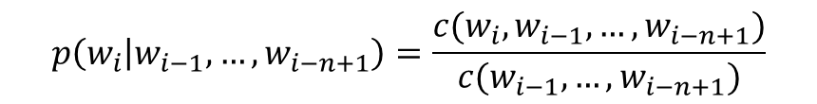

Illustration of N-gram language model smoothing
$$p\left(w_{i} | w_{i−1},…,w_{i−n+1}\right)$$
Max. Likelihood Estimate
$$p\left(w_{i} | w_{i−1},…,w_{i−n+1}\right)=\frac{c(w_{i},w_{i−1},…,w_{i−n+1})}{c(w_{i−1},…,w_{i−n+1})}$$
Smoothed LM
w
Discount from the seen words
Assigning nonzero probabilities to the unseen words

Slide 36

Smoothing methods
Additive smoothing
Add a constant δ to the counts of each word
Unigram language model as an example
Problems?
Hint: all words are equally important?
Counts of w in d
“Add one”, Laplace smoothing
$$p\left(w | d\right)=\frac{c\left(w,d\right)+δ}{\left|d\right|+δ|V|}$$
Vocabulary size
Length of d (total counts)

Slide 37
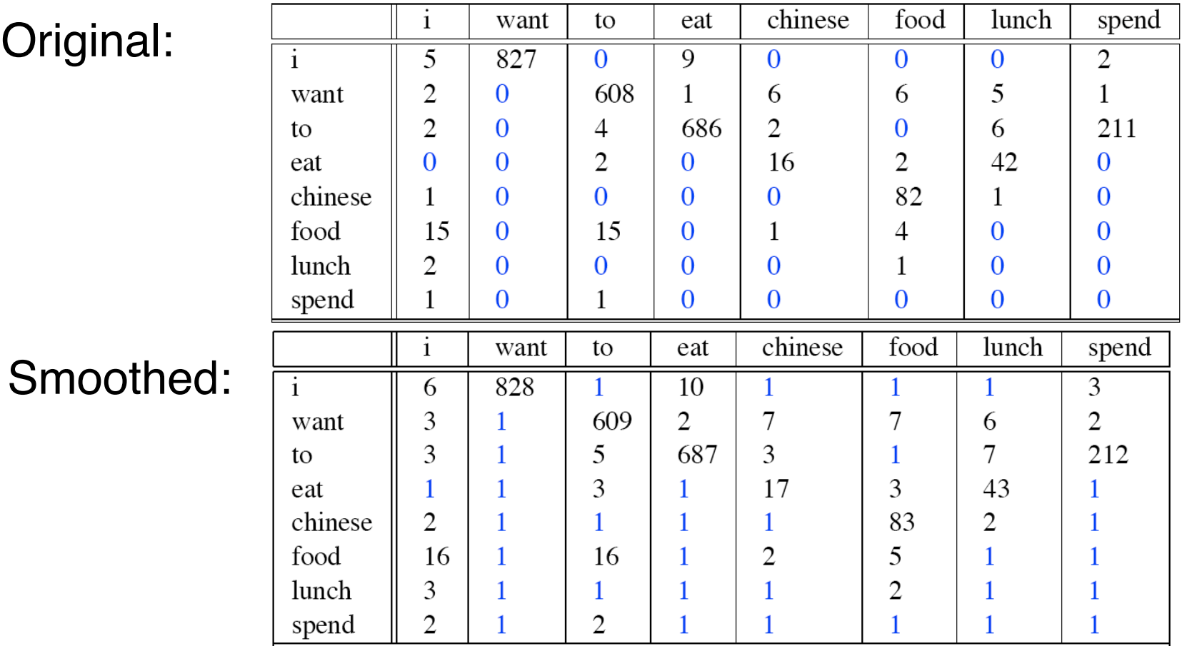
Add one smoothing for bigrams

Slide 38
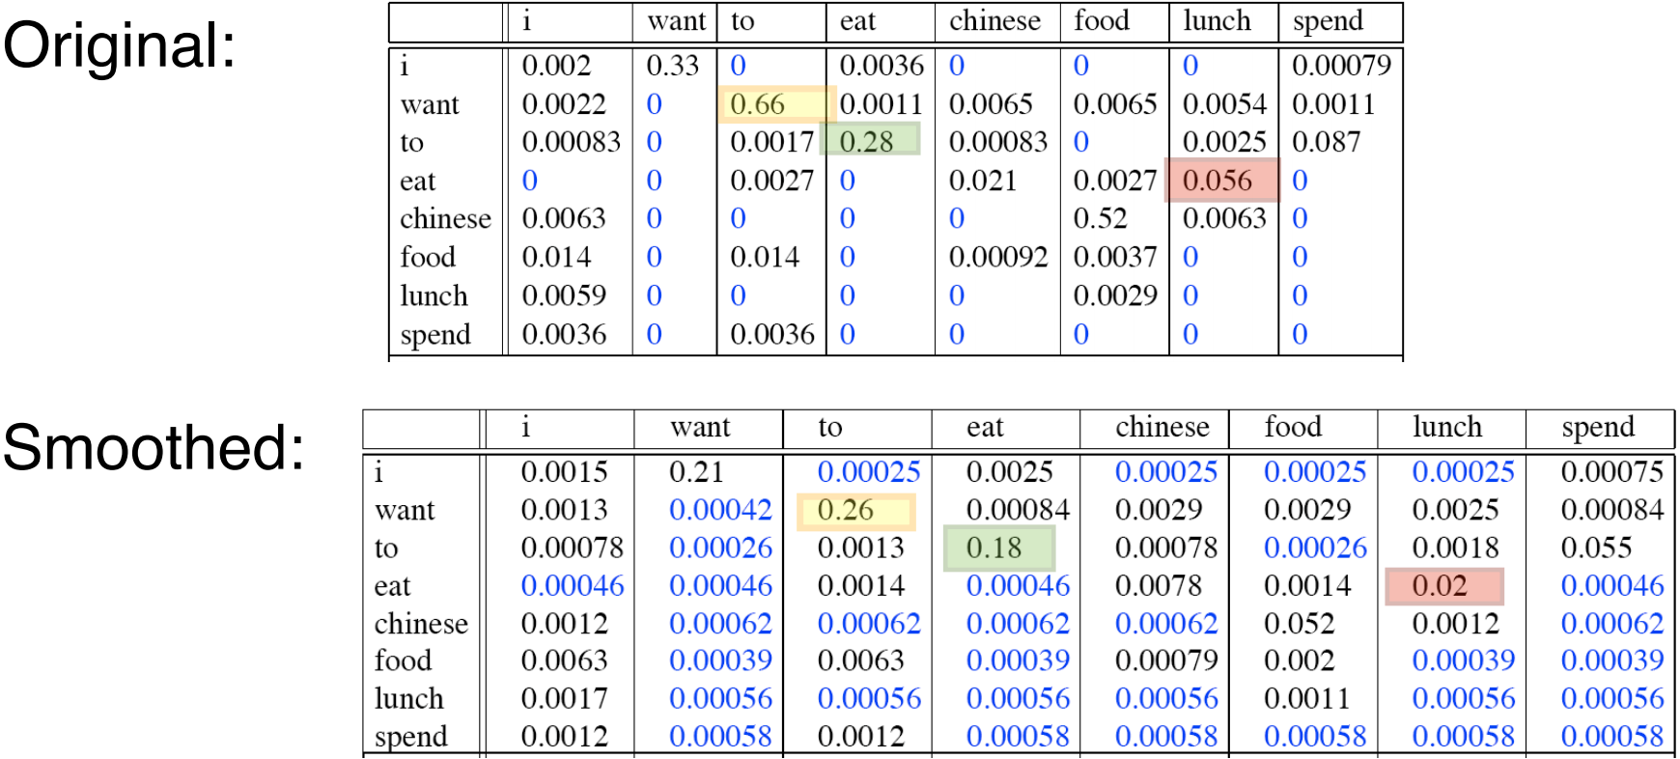
After smoothing
Giving too much to the unseen events

Slide 39
Refine the idea of smoothing
Should all unseen words get equal probabilities?
We can use a reference model to discriminate unseen words
Discounted ML estimate
Reference language model

Slide 40
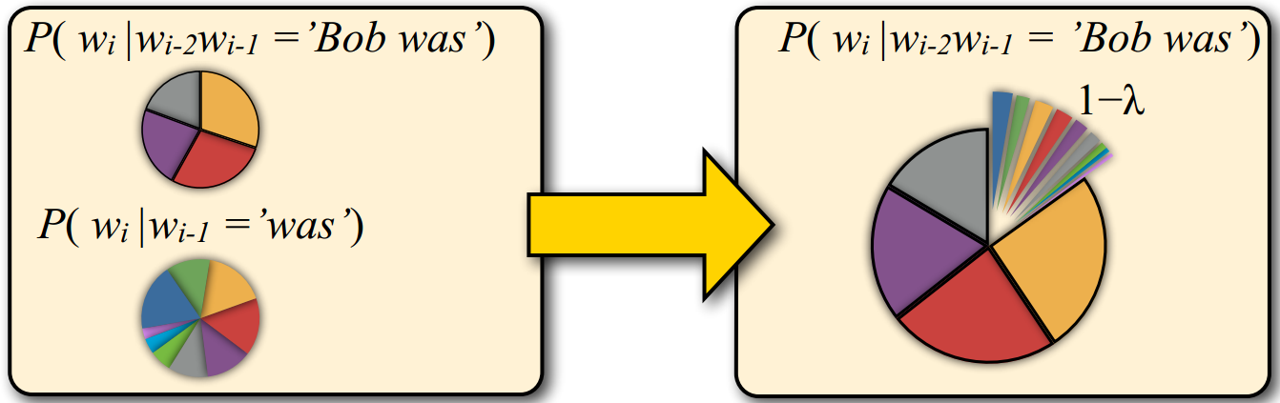
Smoothing methods
Linear interpolation
Use (N –1)-gram probabilities to smooth N-gram probabilities
We never see the trigram “Bob was reading”, but we do see the bigram “was reading”

Slide 41




Smoothing methods
Linear interpolation
Use (N –1)-gram probabilities to smooth N-gram probabilities
Further generalize it
ML N-gram
$$\overline{p}\left(w_{i} | w_{i−1},…,w_{i−n+1}\right)=λp_{ML}\left(w_{i} | w_{i−1},…,w_{i−n+1}\right)$$
$$+(1−λ)\overline{p}\left(w_{i} | w_{i−1},…,w_{i−n+2}\right)$$
Smoothed N-gram
Smoothed (N-1)-gram
$$\overline{p}\left(w_{i} | w_{i−1},…,w_{i−n+1}\right)=λ_{1}p_{ML}\left(w_{i} | w_{i−1},…,w_{i−n+1}\right)$$
$$+λ_{2}\overline{p}\left(w_{i} | w_{i−1},…,w_{i−n+2}\right)$$
$$s.t. \sum_{i=1}^{n}{λ_{i}}=1$$
…….
$$+λ_{n}\overline{p}(w_{i})$$

Slide 42
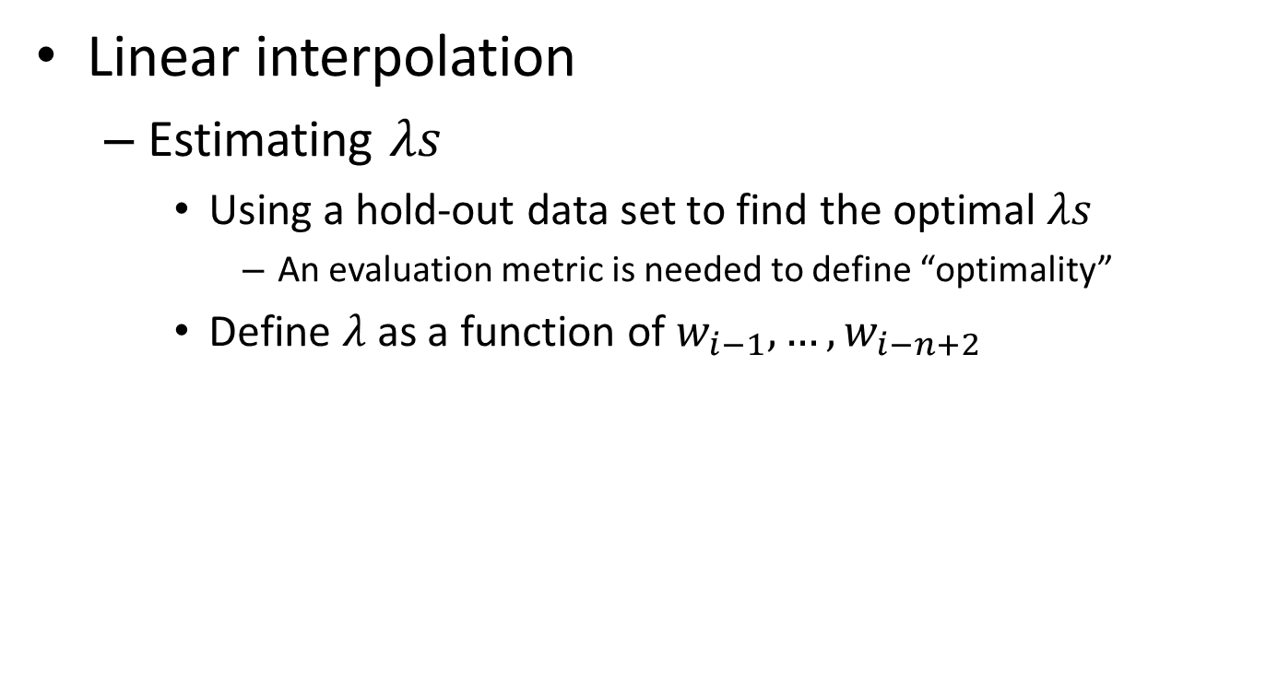
Smoothing methods
Linear interpolation
Estimating $λs$
Using a hold-out data set to find the optimal $λs$
An evaluation metric is needed to define “optimality”
Define $λ$ as a function of $w_{i−1},…,w_{i−n+2}$
We will come back to this later

Slide 43
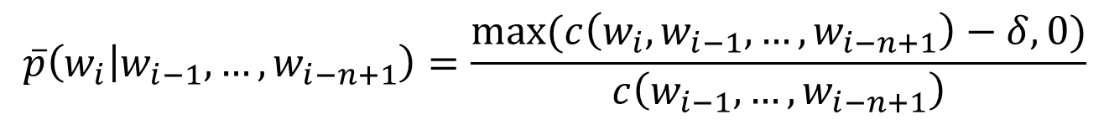
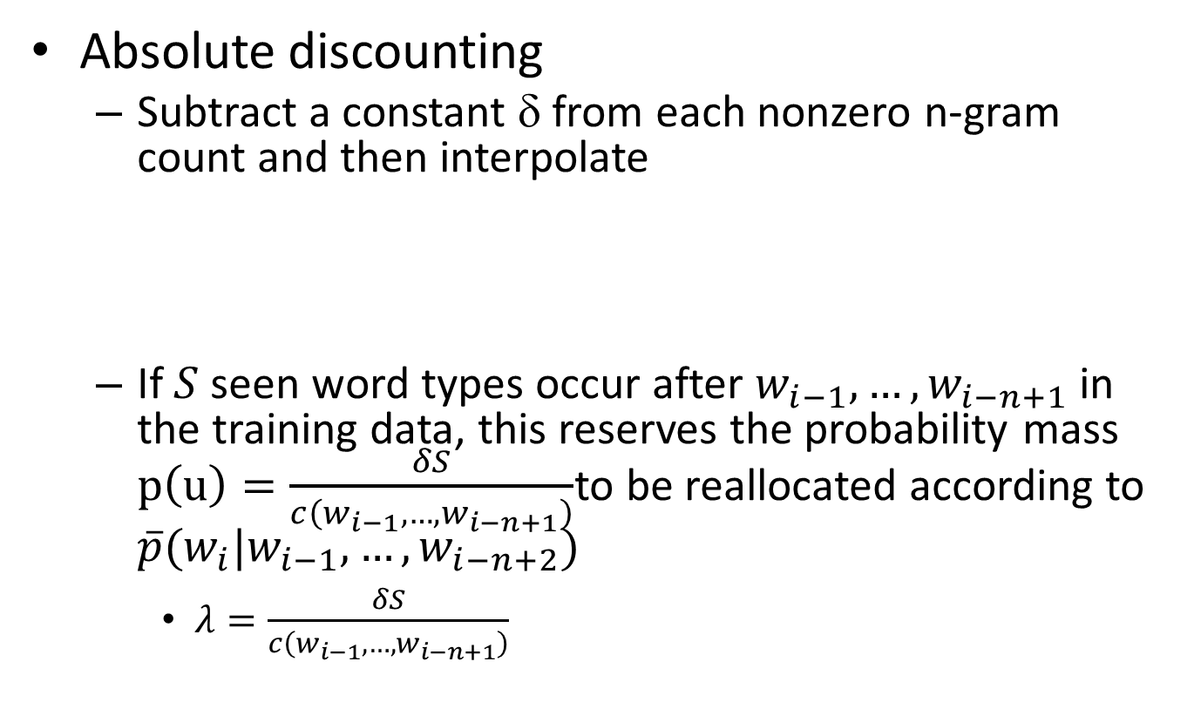

Smoothing methods
Absolute discounting
Subtract a constant δ from each nonzero n-gram count and then interpolate
If $S$ seen word types occur after $w_{i−1},…,w_{i−n+1}$ in the training data, this reserves the probability mass $p\left(u\right)=\frac{δS}{c\left(w_{i−1}, …,w_{i−n+1}\right)}$to be reallocated according to $\overline{p}(w_{i}|w_{i−1},…,w_{i−n+2})$
$λ=\frac{δS}{c\left(w_{i−1}, …,w_{i−n+1}\right)}$
$$\overline{p}\left(w_{i} | w_{i−1},…,w_{i−n+1}\right)=\frac{max⁡(c\left(w_{i},w_{i−1}, …,w_{i−n+1}\right)−δ,0)}{c\left(w_{i−1}, …,w_{i−n+1}\right)}$$
Smoothed N-gram
$$+λ\overline{p}(w_{i}|w_{i−1},…,w_{i−n+2})$$
Smoothed (N-1)-gram

Slide 44
Language model evaluation
Train the models on the same training set
Parameter tuning can be done by holding off some training set for validation
Test the models on an unseen test set
This data set must be disjoint from training data
Language model A is better than model B
If A assigns higher probability to the test data than B

Slide 45
Perplexity
Standard evaluation metric for language models
A function of the probability that a language model assigns to a data set
Rooted in the notion of cross-entropy in information theory

Slide 46
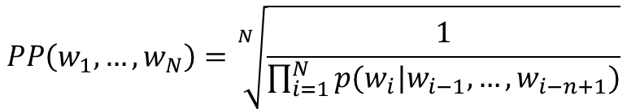
Perplexity
The inverse of the likelihood of the test set as assigned by the language model, normalized by the number of words
$$PP\left(w_{1},…,w_{N}\right)=\sqrt[N]{\frac{1}{\prod_{i=1}^{N}{p(w_{i}|w_{i−1},…,w_{i−n+1})}}}$$
N-gram language model

Slide 47
An experiment
Models
Unigram, Bigram, Trigram models (with proper smoothing)
Training data
38M words of WSJ text (vocabulary: 20K types)
Test data
1.5M words of WSJ text
Results
 | Unigram | Bigram | Trigram
Perplexity | 962 | 170 | 109

Slide 48
What you should know
N-gram language models
How to generate text documents from a language model
How to estimate a language model
General idea and different ways of smoothing
Language model evaluation

Slide 49
Today’s reading
Introduction to information retrieval
Chapter 12: Language models for information retrieval
Speech and Language Processing
Chapter 4: N-Grams

